Slide 1

Mobile Security and Forensics Tools
Under the Guidance of Dr. Vikash Rai Sir
Presented By: Saloni Rangari
Enrolment No.: 240347007003
M.Tech. Artificial Intelligence & Data Science (Specialization In Cyber Security)
Session Year: 2024-26
1st Year 2nd Sem
Subject Name: Mobile Security and Forensics
Subject Code: CTMTAIDS SII P2

Slide 2

Introduction
What is Mobile Security?
Protection of mobile devices and applications from cyber threats.
Involves securing data, network, and device integrity.
What is Mobile Forensics?
Extraction, preservation, and analysis of mobile device data for investigation.

Slide 3
Importance of Mobile Security
Increasing number of mobile threats.
Sensitive personal and financial data at risk.
Rising cases of malware, phishing, and exploits.
Need for security analysis tools.

Slide 4
Overview of Security Tools
QARK – Automated Security Analysis For Android.
Frida – Dynamic instrumentation toolkit.
MobSF – Mobile Security Framework.
Drozer – Android Security Testing Tool.
Xposed Framework – Modifies Android Behavior Without Changing APK.

Slide 5
QARK (Quick Android Review Kit) - Tool Overview
Purpose:
QARK is an automated tool designed for Android security auditing. It identifies common vulnerabilities in Android apps by analyzing APKs and source code.
Features:
Performs static analysis of APKs and source code.
Detects a wide range of vulnerabilities, including insecure storage, hardcoded secrets, and potential attack vectors.
Supported Vulnerabilities:
Insecure WebView usage.
Missing proguard rules.
Hardcoded secrets.
Improper usage of SSL.

Slide 6
QARK - Installation Steps
1. Clone the repository: `git clone https://github.com/linkedin/qark.git`
2. Navigate into the QARK directory: `cd qark`
3. Install pip if not already installed: `sudo apt install python-pip`
4. Install QARK: `sudo python3 setup.py install`

Slide 7
QARK - Usage
1. Run QARK with the APK or source code path: `qark --source <path_to_apk_or_source_code>`
2. Review the generated report for security issues.
The report includes a list of detected vulnerabilities with recommendations for mitigation.

Slide 8
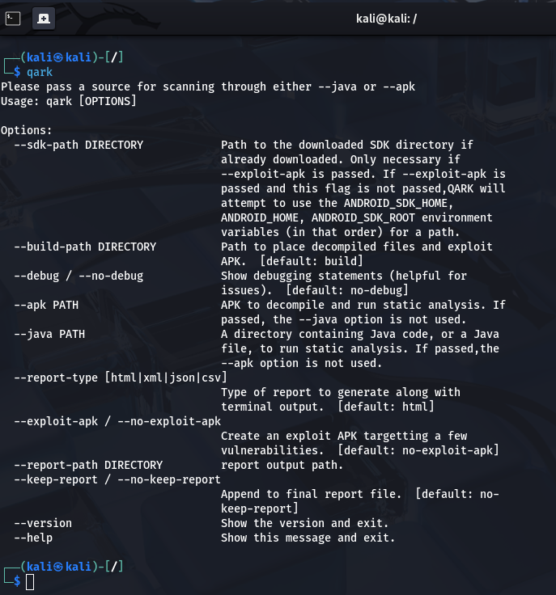
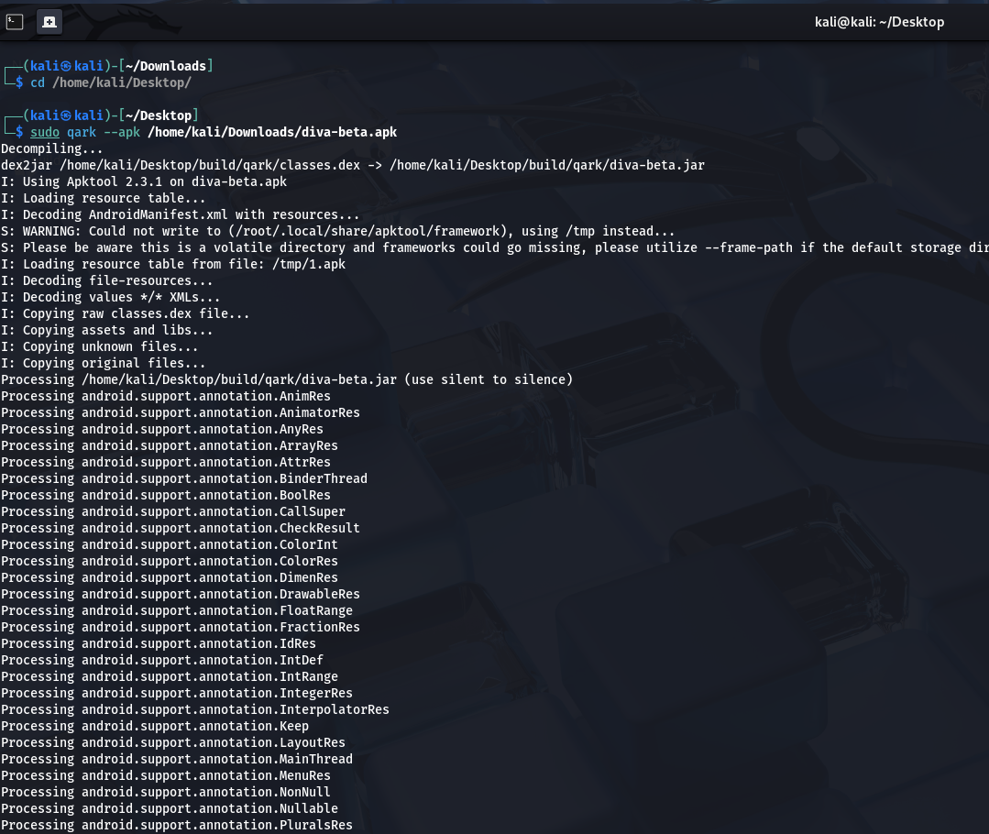
QARK - Screenshot

Slide 9
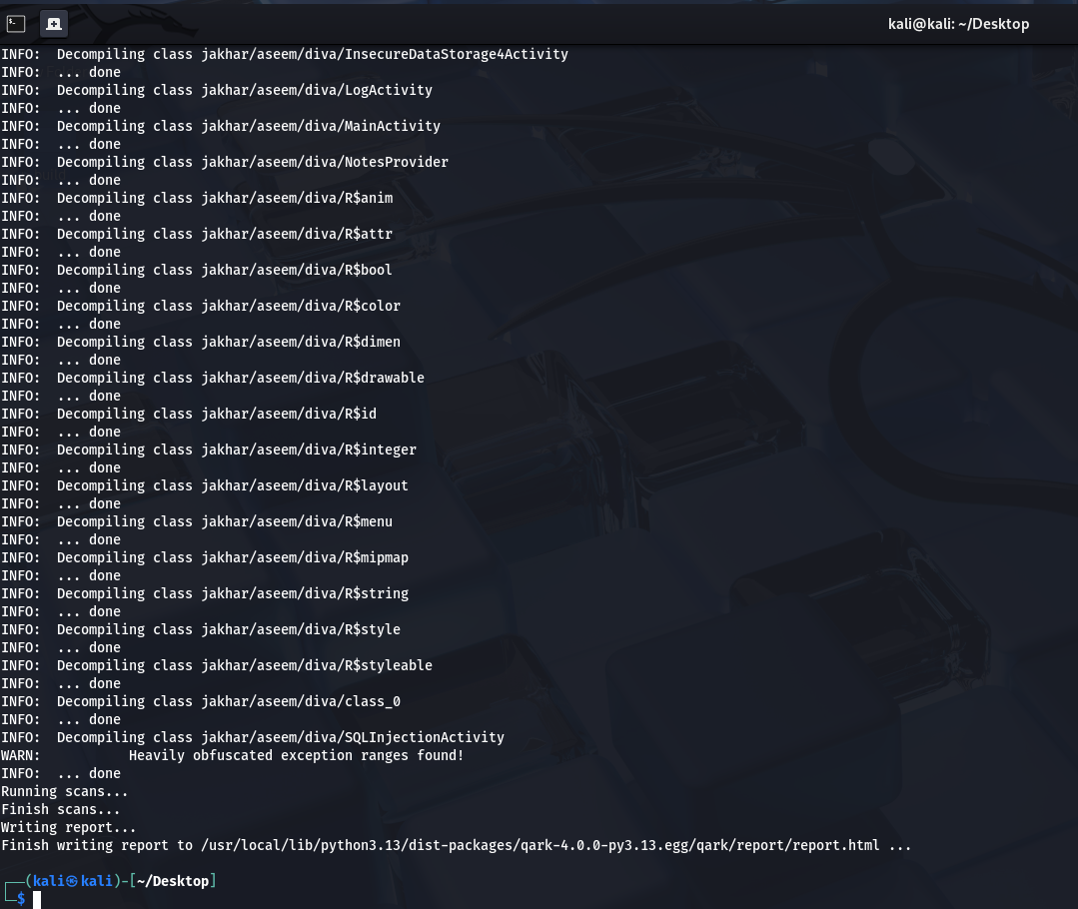
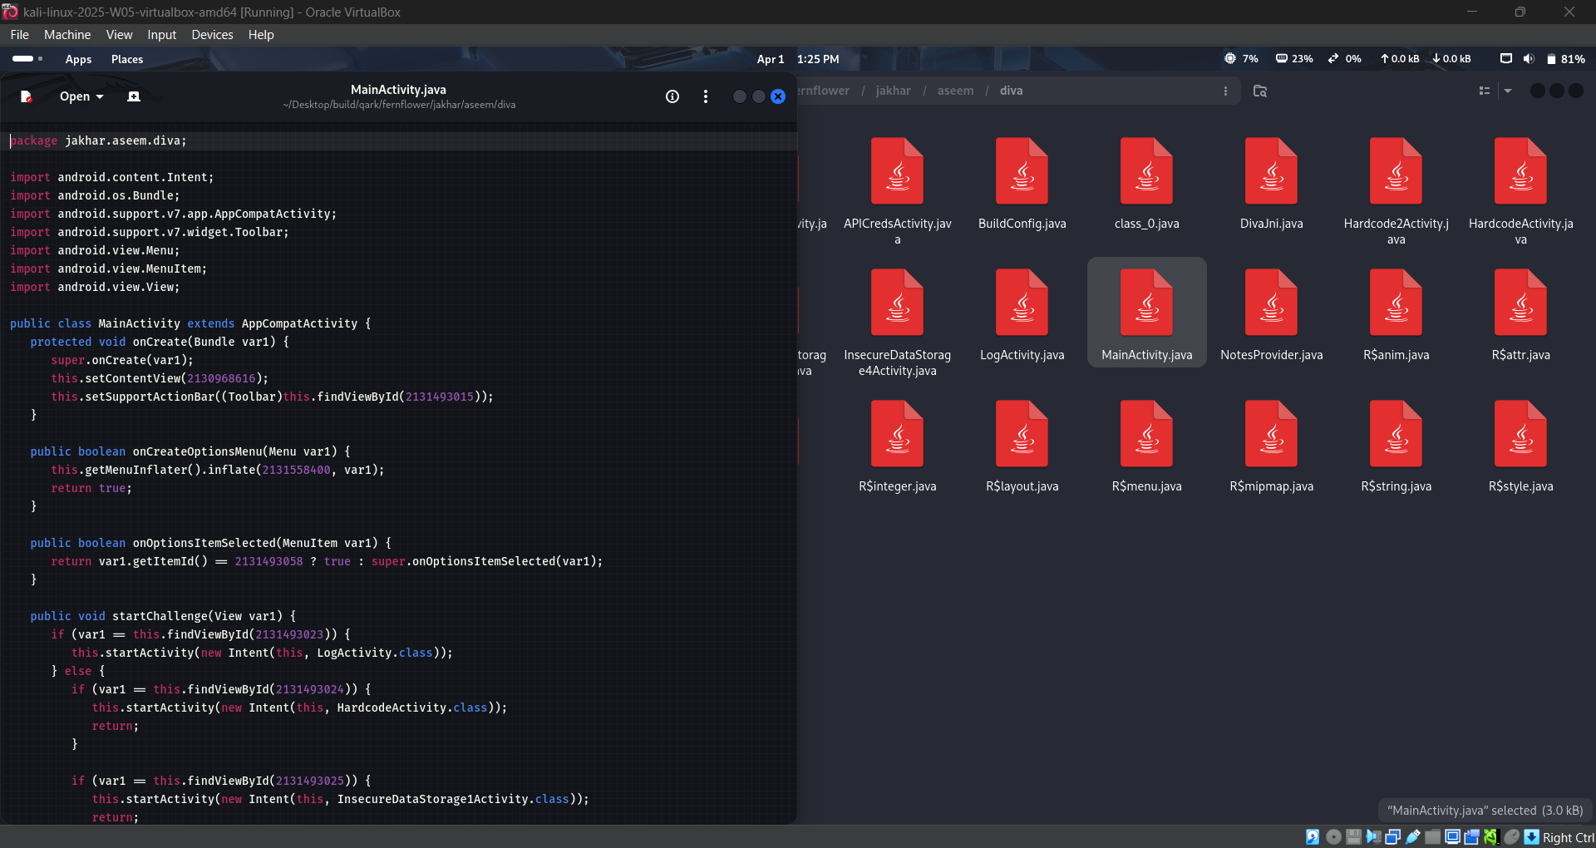
QARK - Screenshot

Slide 10
Frida - Tool Overview
Purpose:
Frida is a dynamic instrumentation tool that allows developers and researchers to perform reverse engineering of mobile apps.
Features:
It can intercept and modify API calls at runtime.
Useful for bypassing SSL pinning, inspecting app behavior, and reverse engineering.
Supported Platforms:
Android and iOS.

Slide 11
QARK - Installation Steps
1. Install Frida on Windows: `pip install frida`
2. Navigate into the QARK directory: `cd qark`
3. Install additional dependencies, such as `libimobiledevice` for iOS support.

Slide 12
Frida - Usage
1. Start Frida with the app's process name: `frida -U -n <app_name>`
2. Install Frida on Kali Linux: `sudo apt install frida`
3. Example script usage to hook into a method: `frida -U -n <app_name> -l hook.js`

Slide 13
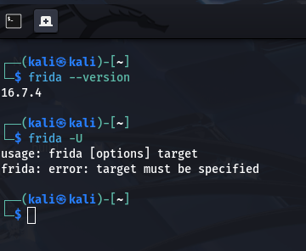
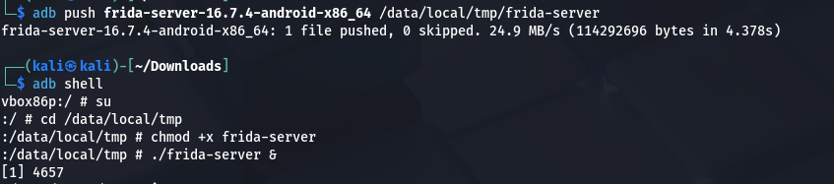
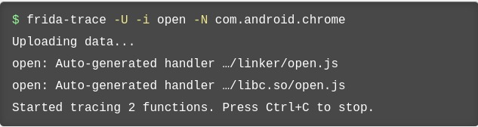
Frida - Screenshot

Slide 14
MobSF (Mobile Security Framework) - Tool Overview
Purpose:
MobSF is an all-in-one mobile application security testing framework that provides both static and dynamic analysis for Android and iOS apps.
Features:
Static analysis of APK and IPA files.
Dynamic analysis using the integrated mobile app testing environment.
Malware analysis, API monitoring, and more.
Supported Platforms:
Android and iOS.

Slide 15
MobSF - Installation Steps
1. Clone the repository: `git clone https://github.com/MobSF/Mobile-Security-Framework-MobSF.git`
2. Navigate to the MobSF directory: `cd Mobile-Security-Framework-MobSF`
3. Run the setup script (for Kali Linux): `./setup.sh3. Install pip if not already installed: `sudo apt install python-pip`

Slide 16
MobSF - Usage
1. Start the MobSF server: `python3 manage.py runserver`
2. Access via the browser: `http://localhost:8000`
3. Upload APK/IPA files for analysis and receive detailed security reports.

Slide 17
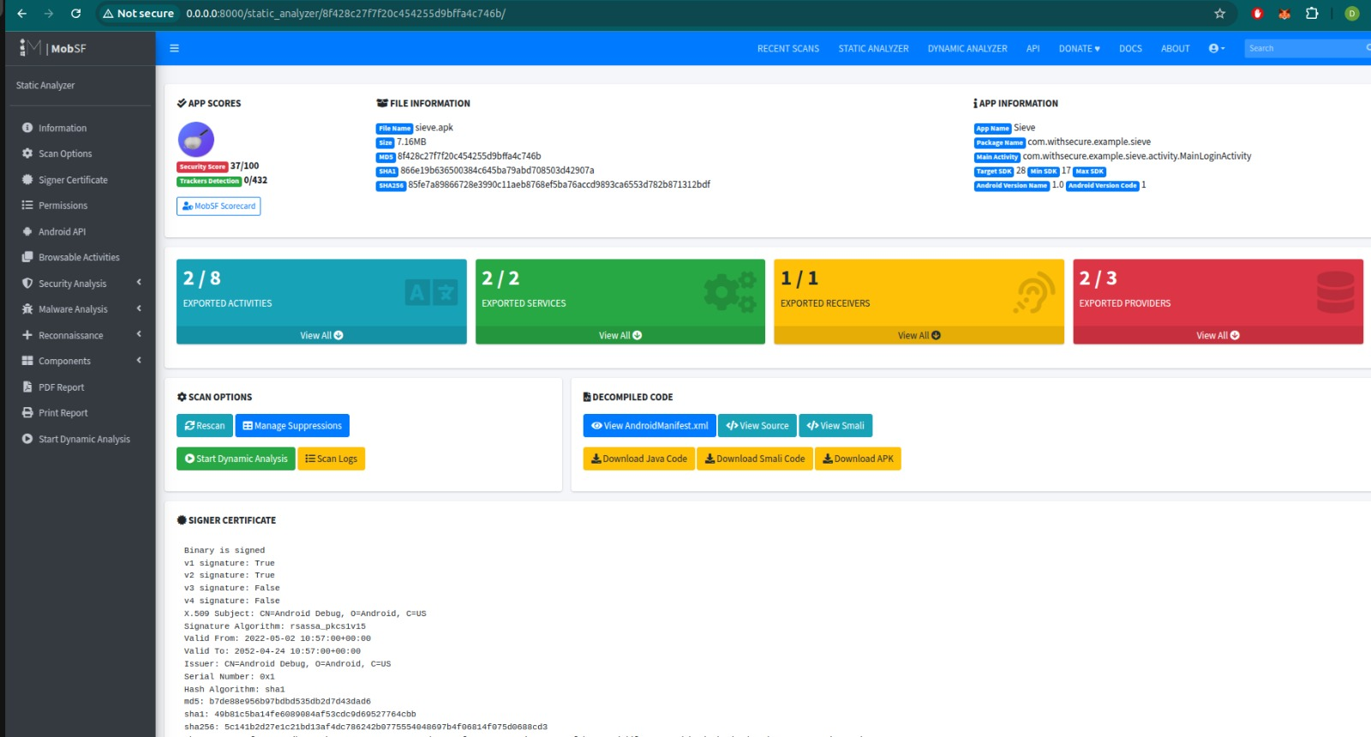
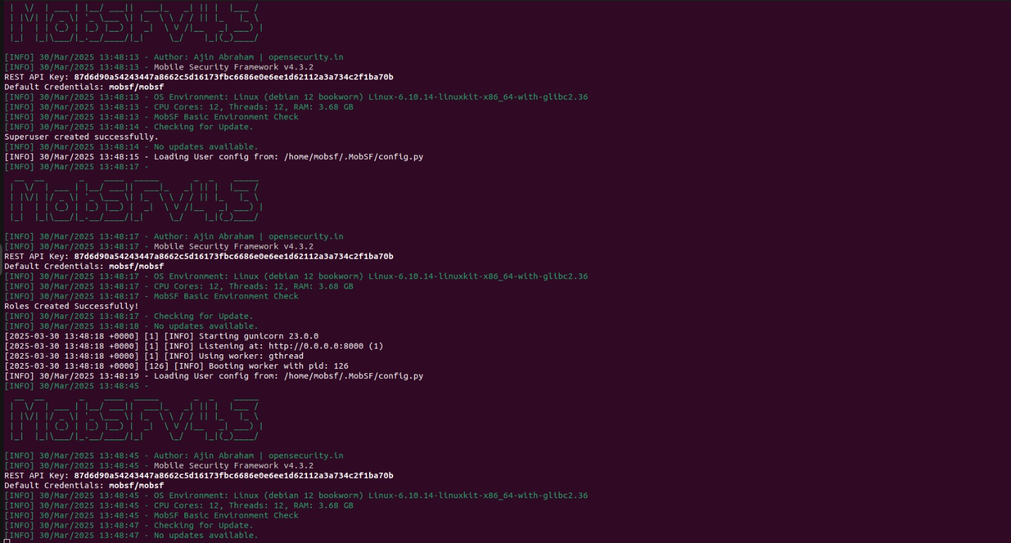
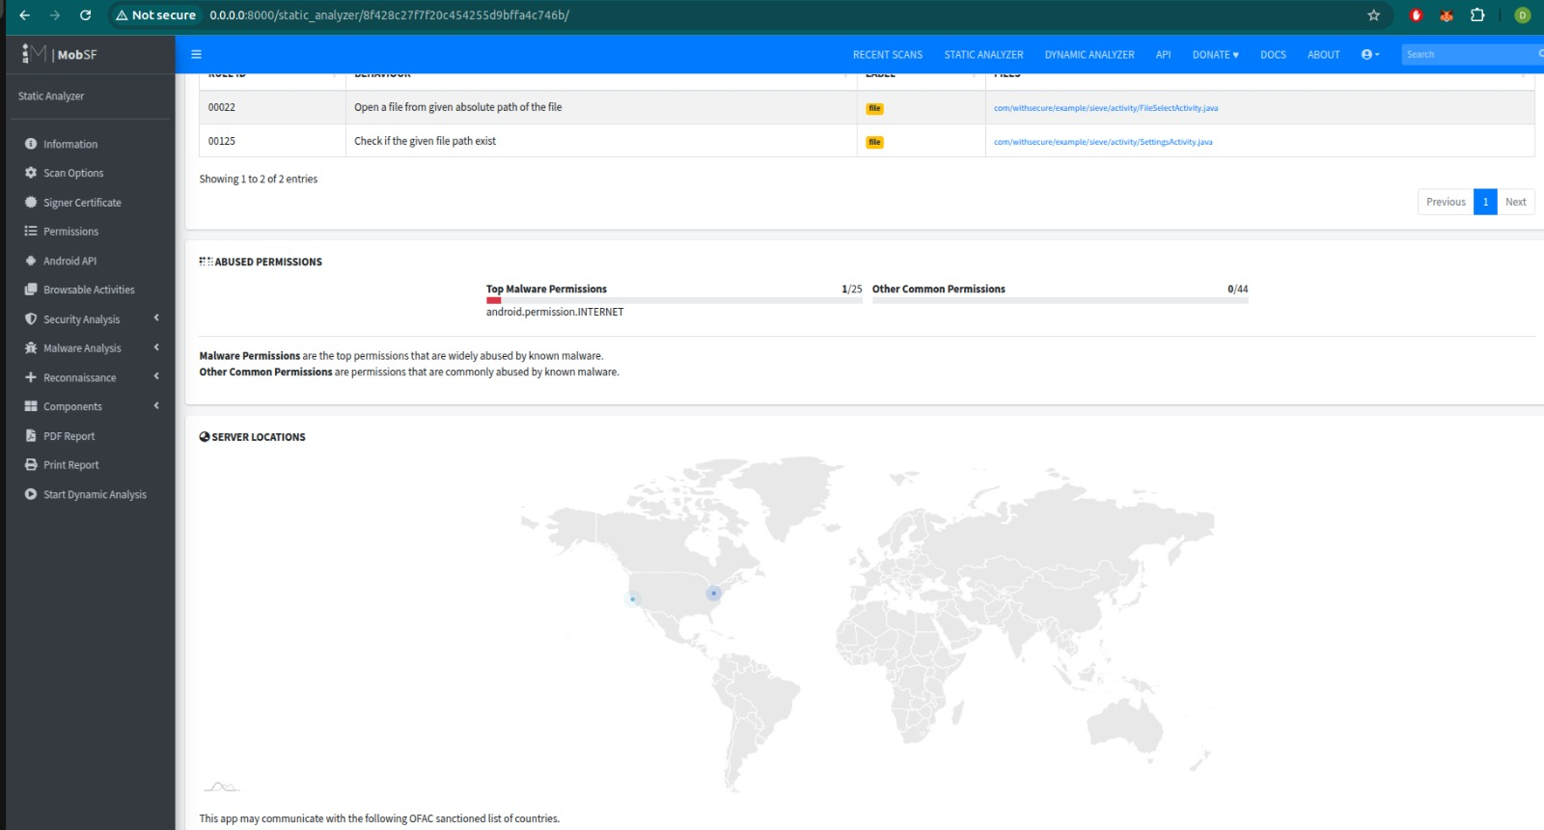
MobSF - Screenshot

Slide 18
Drozer - Tool Overview
Purpose:
Drozer is a security testing framework designed for Android applications, enabling security researchers to test app components and interact with vulnerable apps.
Features:
Allows exploitation of Android vulnerabilities.
Provides access to a wide array of app components like activities, services, and content providers.
Supported Platforms:
Android

Slide 19
Drozer - Installation Steps
1. Install Drozer on Windows: `pip install drozer`
2. Install Drozer on Kali Linux: `sudo apt install drozer`
3. Download and install Drozer Agent on the Android device from GitHub: `adb install drozer-agent.apk`

Slide 20
Drozer - Usage
1. Start the drozer console: `drozer console connect`
2. List installed apps: `run app.package.list`
3. Interact with app components: `run app.activity.info -a <package_name>`

Slide 21
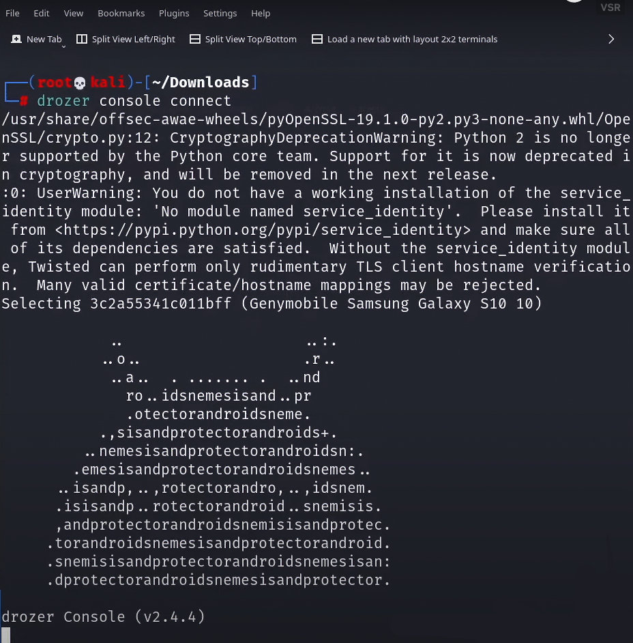
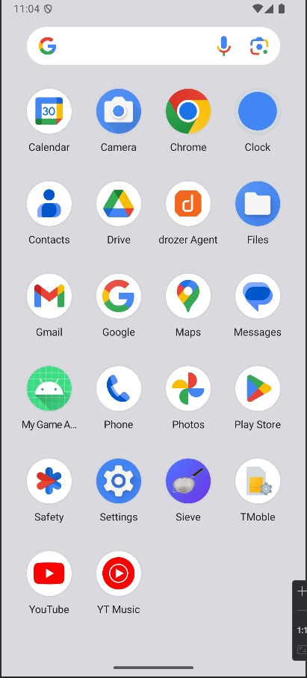
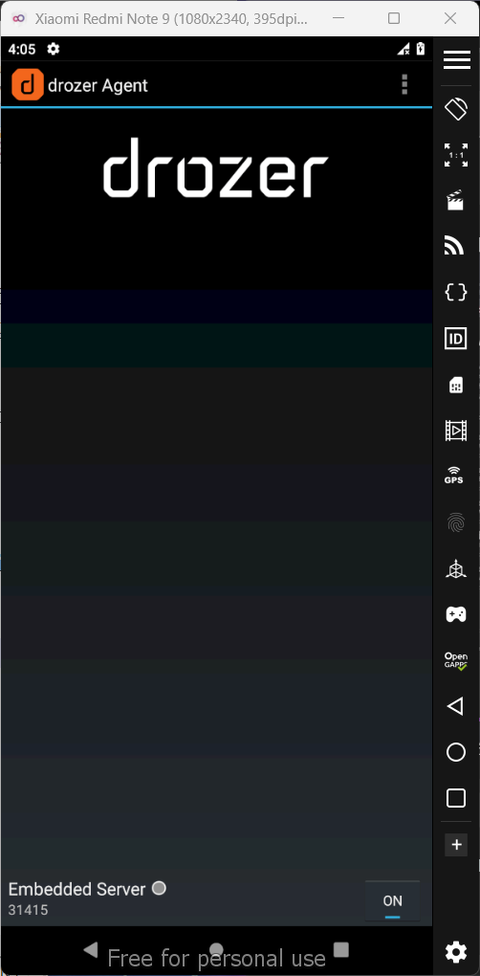
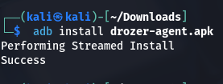
Drozer - Screenshot

Slide 22
Xposed Framework
Purpose:
Framework to modify Android behavior without modifying APKs.
Helps in security testing, app debugging, and feature enhancement.
Allows runtime modification of system and app behavior.
Features:
Hooks into Android apps and system processes.
Enables customization without modifying system files.
Used for reverse engineering and security testing.
Supports modules for extensive modification
Supported Platforms:
Android (requires root access).
Works with Magisk for systemless installation.
Supports Android versions from Lollipop to the latest (with compatible modules).

Slide 23
Xposed - Installation Steps
From Windows 11:
From Kali Linux:
Install Xposed Installer APK
Install via Magisk or Recovery

Slide 24
Xposed Usage
1. Open Xposed Installer
2. Enable modules and reboot
3. Use modules for security analysis

Slide 25
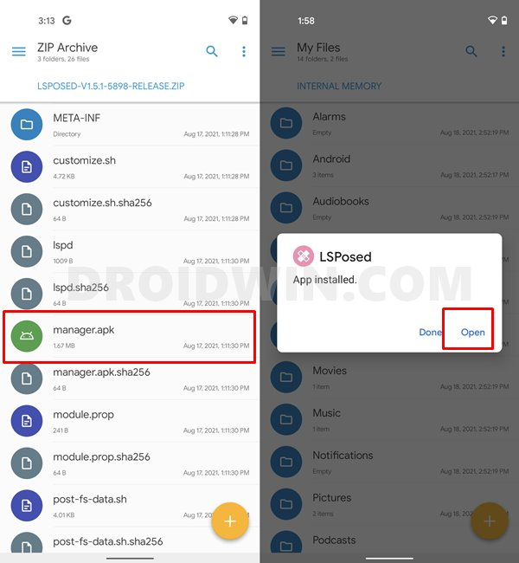
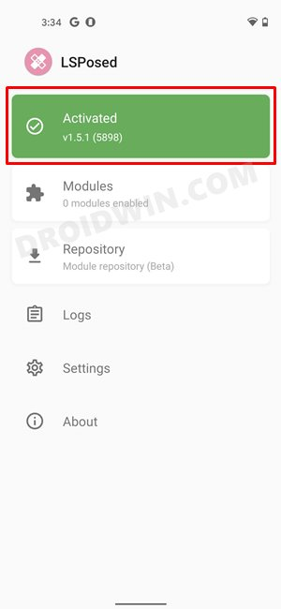
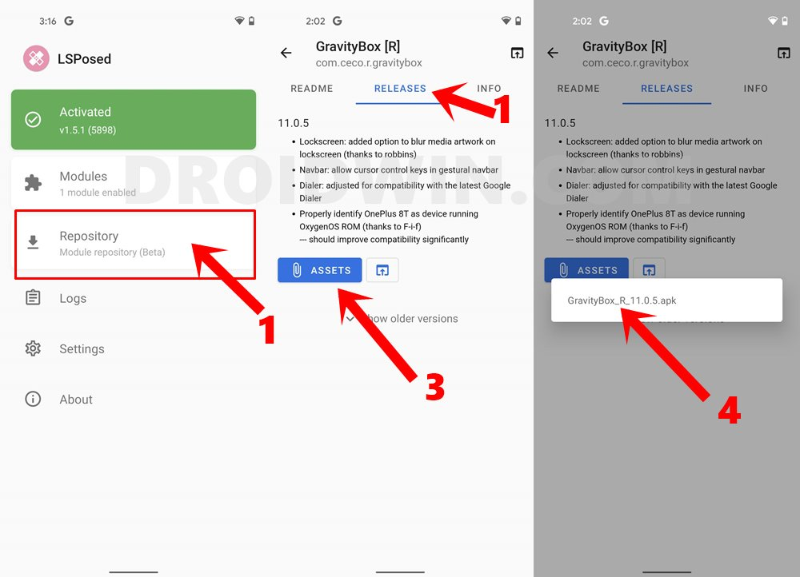
Xposed - Screenshot

Slide 26






Thank You

